Slide 1




Healthy teams achieve better results.
AI -Based Employee Wellness Management
Platform
Support Employee’s Mental Health and Sentiment Remotely
Presented By:
Team 4
Rishit Ranjan
Ritheesh Reddy
Sanjana Teggi
Simran Hakim
Shivendra Tripathi
Sudip Madhu

Slide 2





Problem Statement
Current System’s Limitations and Issues
Lack of a secure and centralized login and wellness management system.
Difficulty in managing user/admin access and employee wellness records.
Limited real-time analysis of workforce performance and health trends.
Need for instant wellness guidance through an intelligent chatbot with natural language response.

Slide 3

Knowing about the Project
Employee wellness is essential for strong productivity and steady growth. The system helps manage health data and spot risks like stress while offering personal wellness tips.
Employee wellness plays a big role in performance and growth. This system handles health data, predicts risks, and gives each person wellness ideas that support their wellbeing.
Supporting employee wellness leads to better focus and stronger results. The system works with wellness data, identifies stress risks, and shares recommendations and the sentiment to help everyone stay healthy.
Introduction

Slide 4


Project Objective
Objectives of the Project
Personalized Employee Dashboards: Tracks vitals, sets goals, and delivers custom AI insights.
Proactive Admin Analytics: Enables predictive risk modeling, sentiment tracking, and key KPIs.
24/7 AI Wellness Assistant: Provides instant, contextual advice on diet, stress, and exercise.
Secure & Scalable Infrastructure: Ensures data privacy, role-based access, and centralized analytics.
Automated Admin & Emergency Response: Streamlines claims, scheduling, and instant SOS alerts.

Slide 5

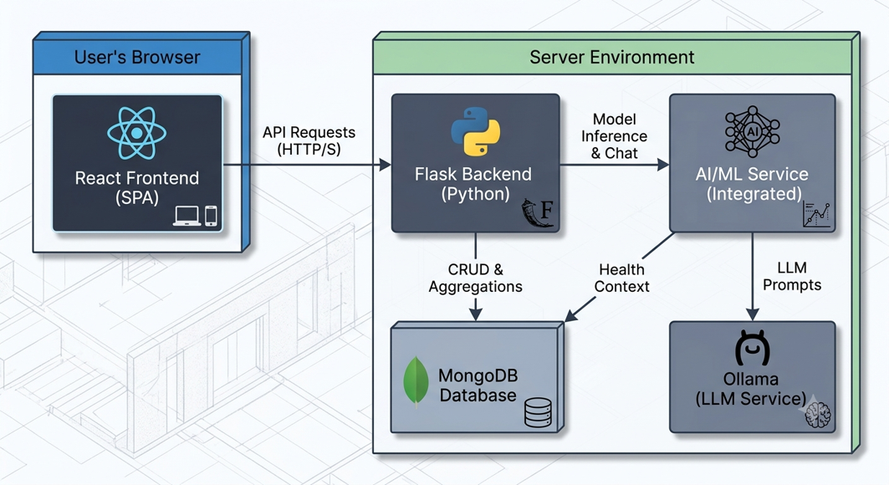
System Architecture
Explaining the structure and flow of the system.
The application is built on a modern, decoupled architecture, commonly known as a Backend for Frontend (BFF) pattern.
This means the React frontend is a distinct application that communicates with a dedicated Flask backend via a REST API
Microservice-Ready AI Integration: Isolates LLM interactions and machine learning model inference into modular background services to maintain high responsiveness and system efficiency.
Stateless Token Authentication: Utilizes secure JWT authorization across API requests, ensuring strict role-based access control and seamless horizontal scaling.

Slide 6


Methodology
How the system was developed and works step-by-step.
The system was developed in a modular way, starting with secure user authentication and role-based access for employees and admins.
After that, the frontend, backend, and database were connected to manage wellness records, analytics, and user interactions smoothly.
Finally, AI-based features such as risk prediction, recommendations, sentiment analysis, performance analytics, and chatbot support were added to make the platform smarter and more useful.

Slide 7
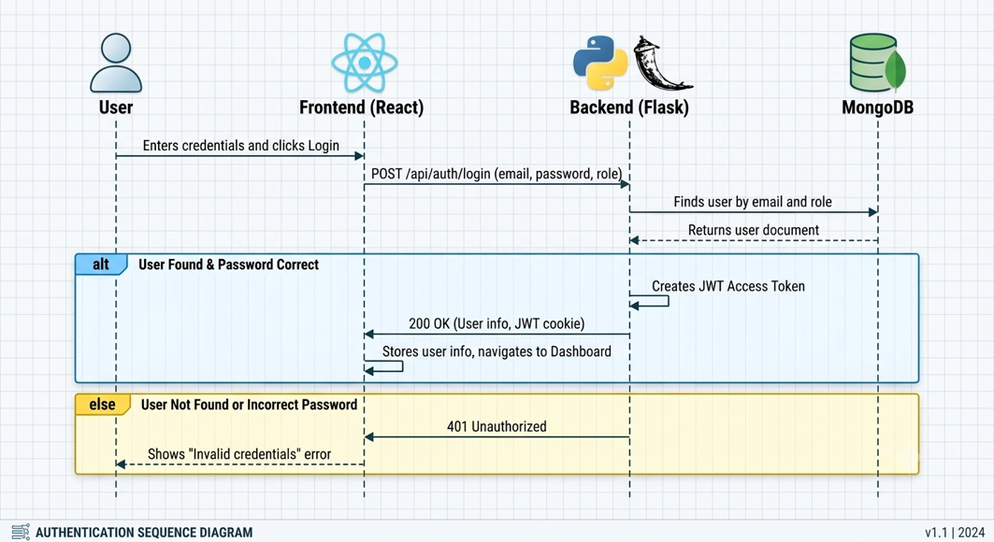
User Authentication Flow
Employee Journey
Auth & Profile: User registers/logs in using JWT authentication → Dashboard loads.
Data Input: User logs daily habits, sleep, exercise, and mental health feedback.
Interaction: User requests personalized meal/fitness plans or chats with the InfyWell AI Assistant.
Action & Emergency: User books checkup appointments or triggers an Emergency SOS alert.

Slide 8
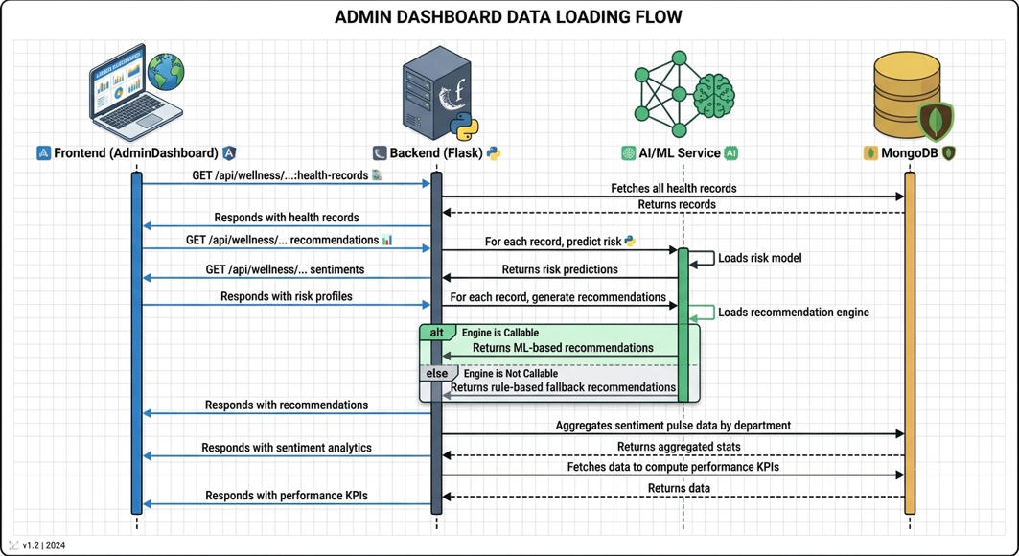
Admin Flow
HR/Management Overview
Dashboard Access: Admin authenticates → Views organization-wide health records and department filters.
Analytics Monitoring: Admin monitors burnout risk trends, absenteeism rates (3.6%), and overall workforce risk metrics.
System Management: Admin adjusts risk thresholds (e.g., High Risk = 70), configures privacy settings, manages insurance claims, and sends broadcast notifications.
Emergency Handling: Admin receives real-time SOS alerts and health checkup logs.

Slide 9
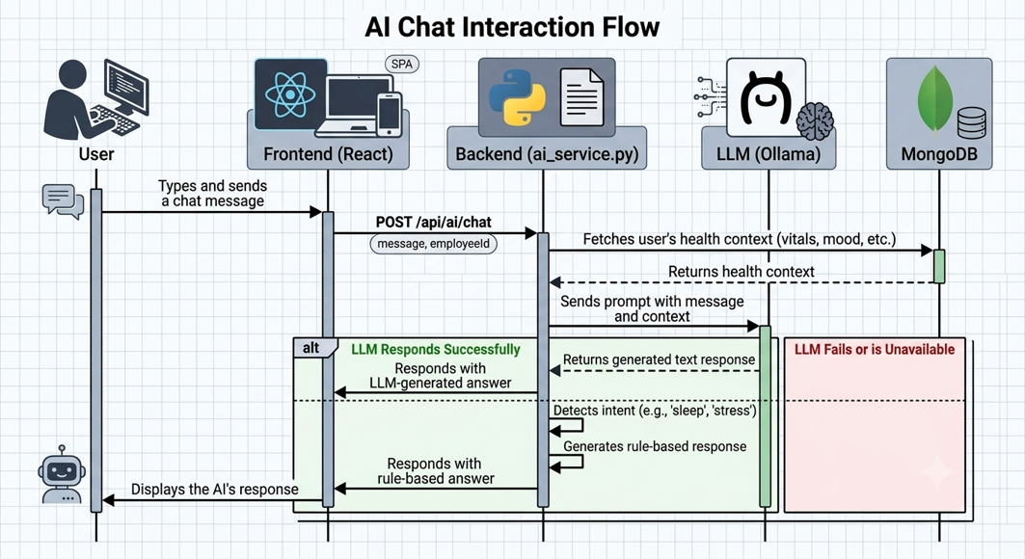
AI Chat Interaction Flow
Data Processing Engine
Data Ingestion: Collects raw health metrics, BMI, blood pressure, and text feedback from MongoDB.
Inference Pipeline:
ML Models (Random Forest/Decision Tree): Calculates risk severity scores (<45% Low, 45-60% Moderate, >75% High).
NLP Engine: Performs sentiment and emotion analysis on employee feedback/logs.
Ollama LLM Service: Ingests health context and user prompts to generate personalized daily tips, diets, and conversational advice.
Output Delivery: Renders predicted risks and recommendations back to React Frontend dashboards in real time.

Slide 10


Software Specification
Software Requirements to run on local machine
Flask API with Python and NodeJs.
Database: MongoDB.
Authentication: JWT and bcrypt for secure login and password handling.
Tools/Libraries: React Router, Flask-CORS, PyMongo, and ML libraries for wellness analytics.

Slide 11






Core
Modules

Slide 12
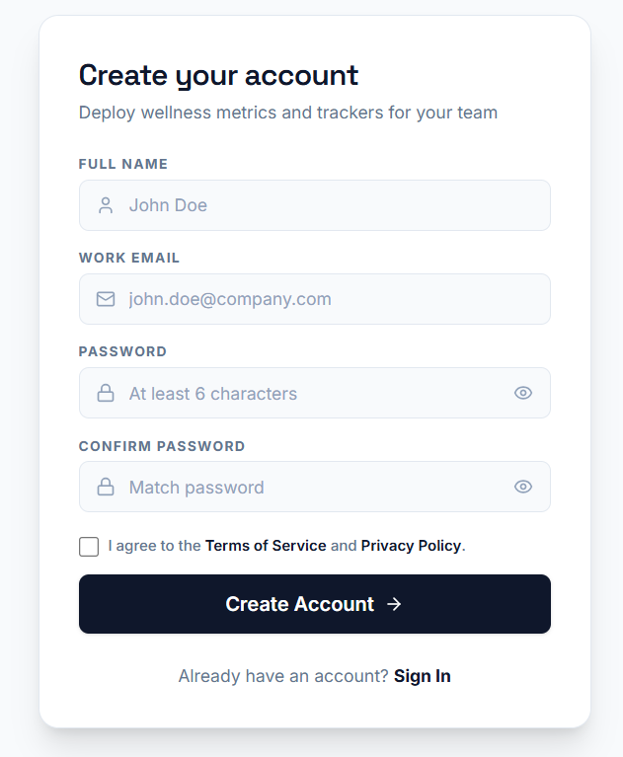
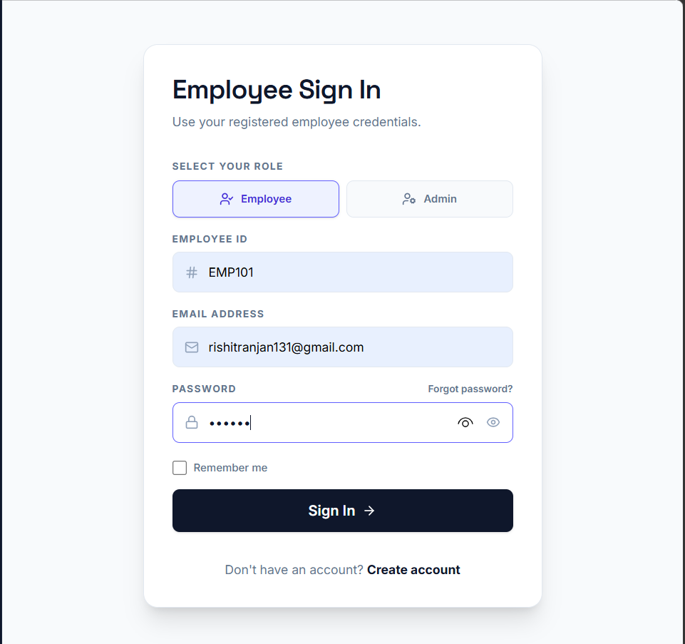


Login
&
SignUp
Module
SignUp and SignIn
User login with email and password.
User registration with required fields.
Remember me option in login form.
Forgot password flow with email, OTP, and reset password steps in the frontend prototype.
Role-based redirect to user or admin dashboard after authentication.

Slide 13
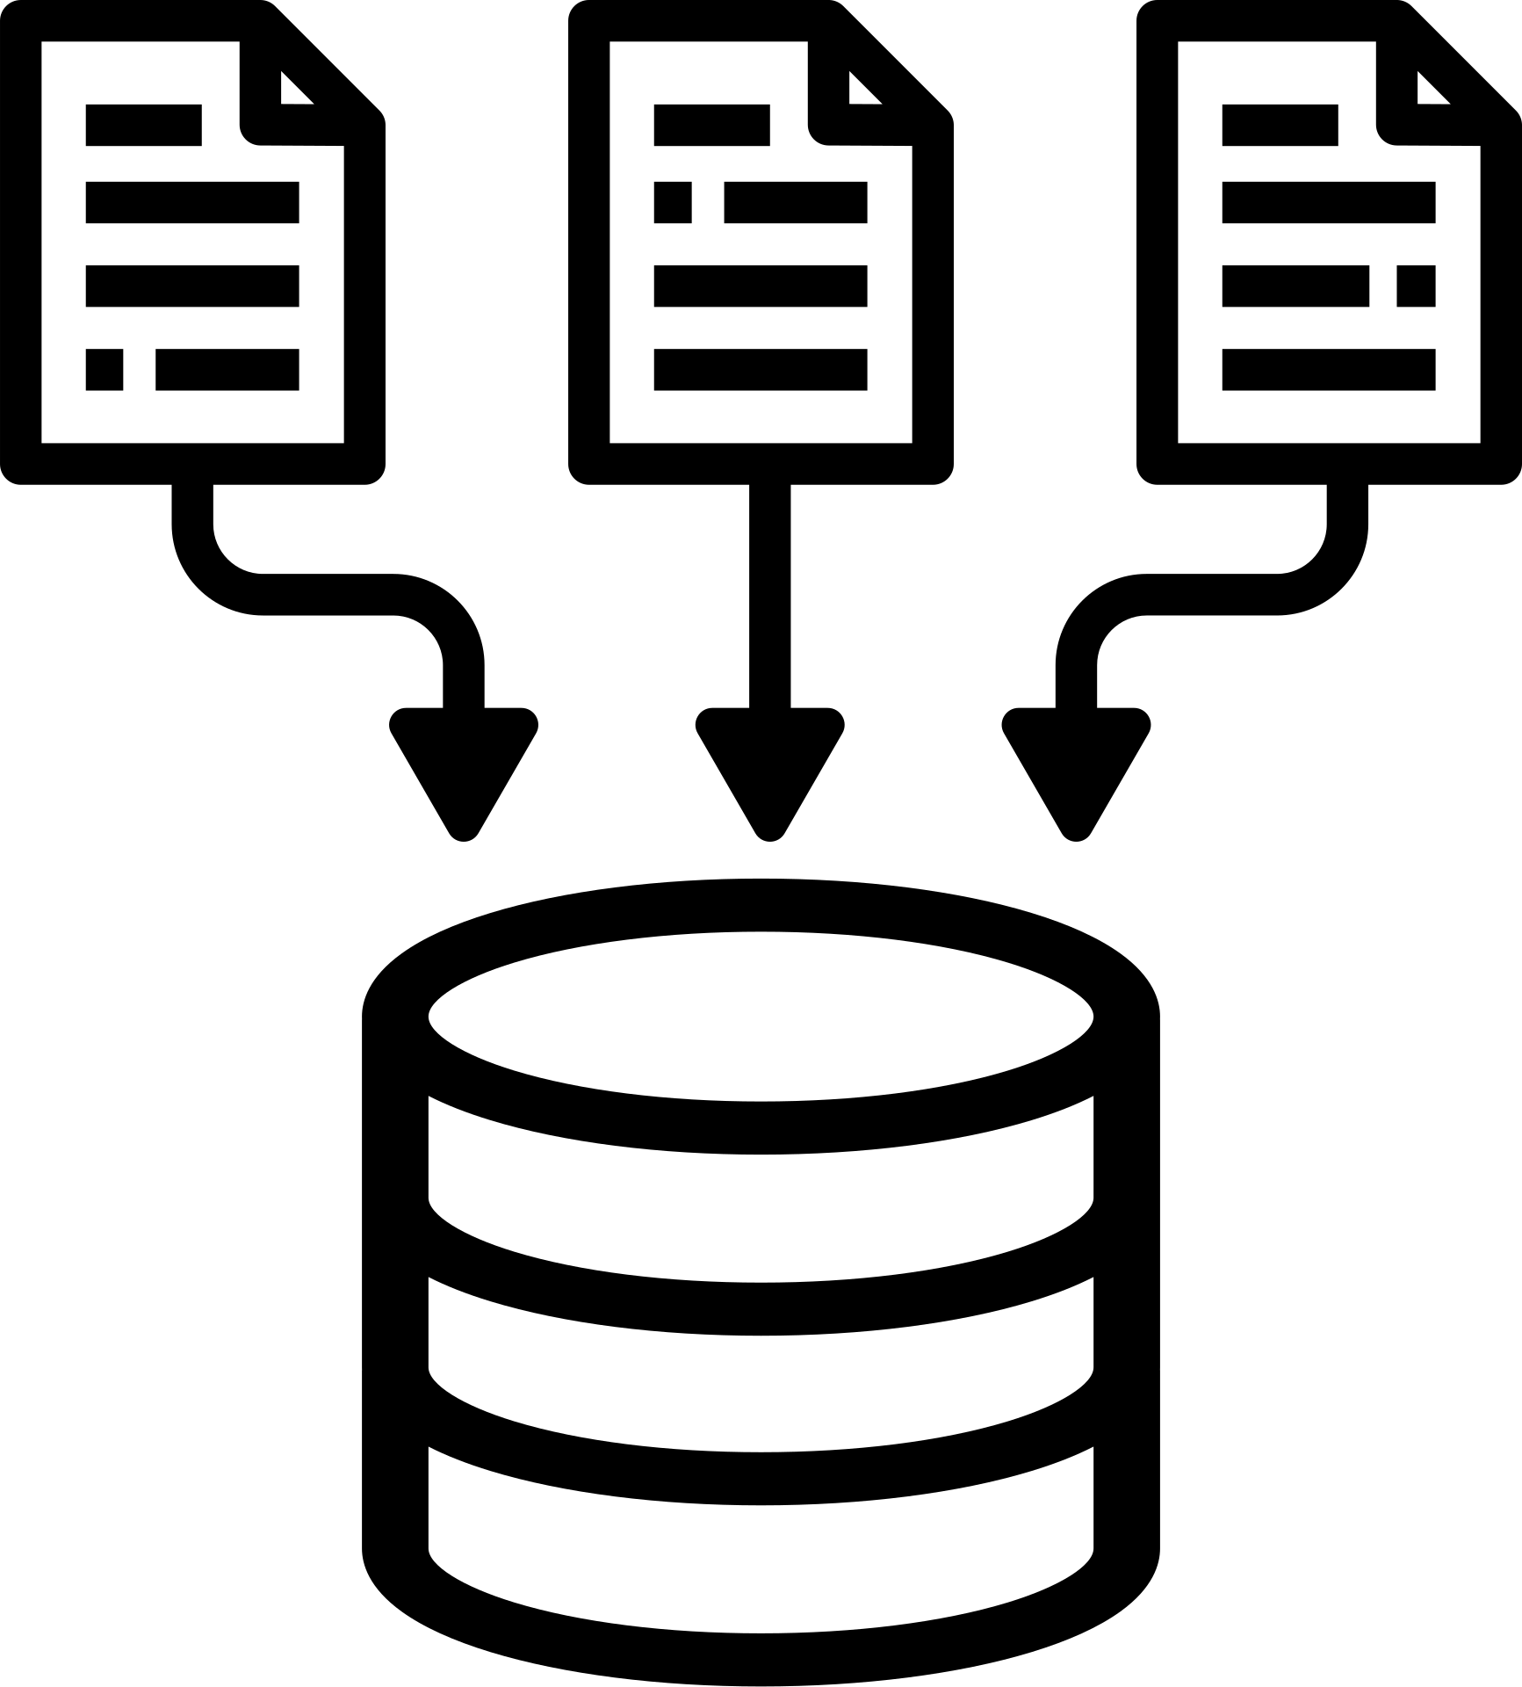
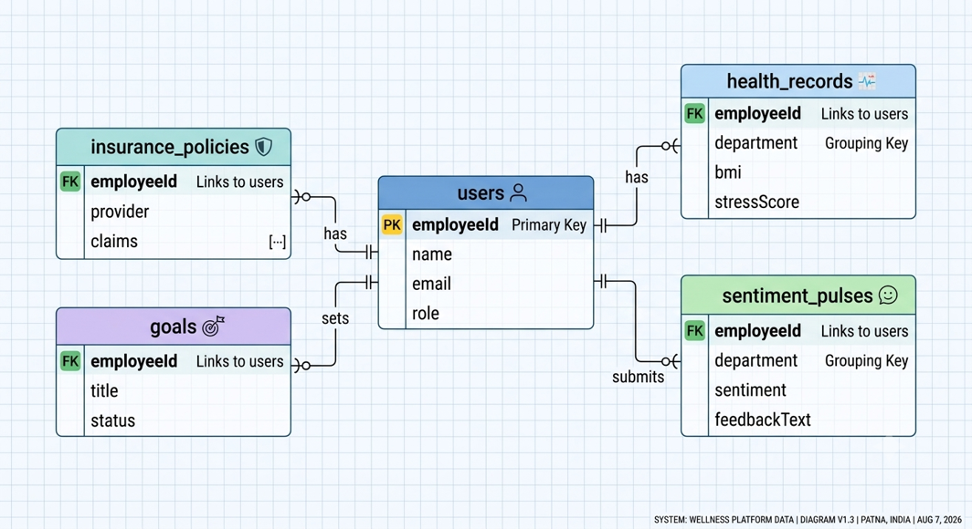
Database
Database Management of the Employee Data
The backend connects to MongoDB using PyMongo.
User-related data is stored in collections including admin and employees in JSON - like format.

Slide 14

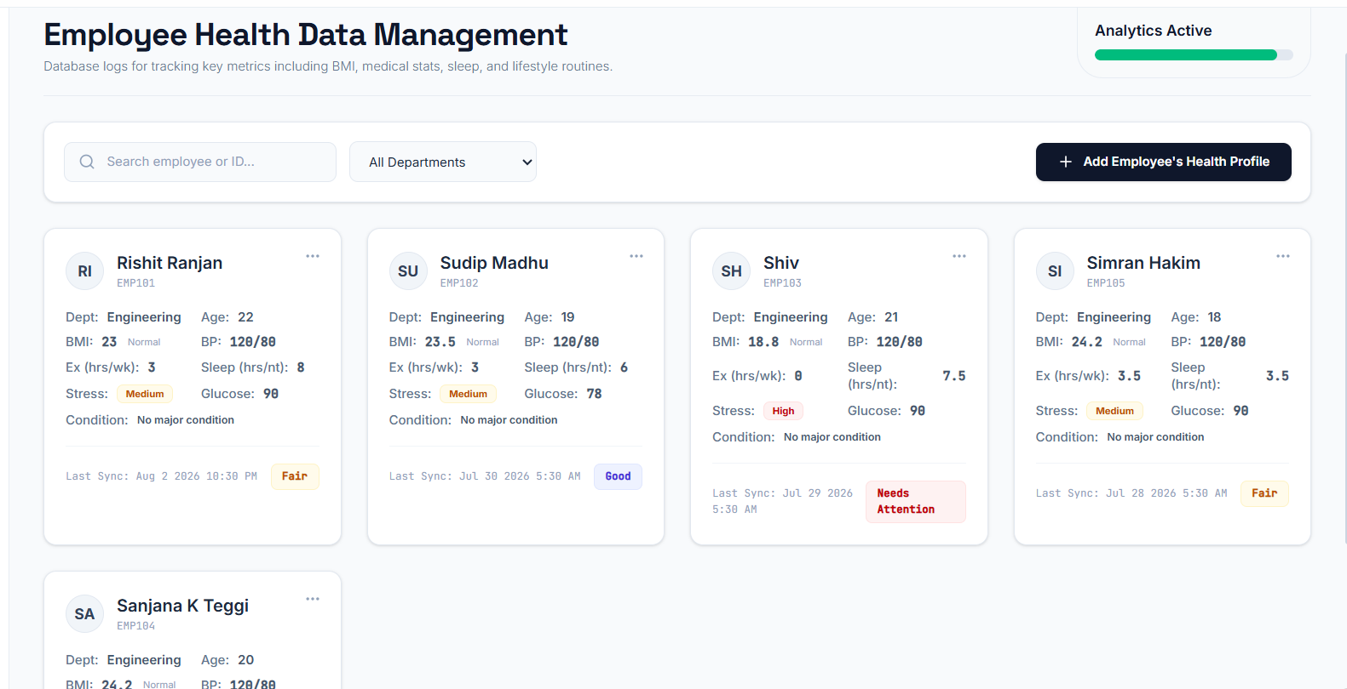
Health Records Collection
Collecting the Health Record
BMI and medical reports.
Exercise and sleep tracking.
Attendance and assessments.
Data preprocessing and validation.

Slide 15
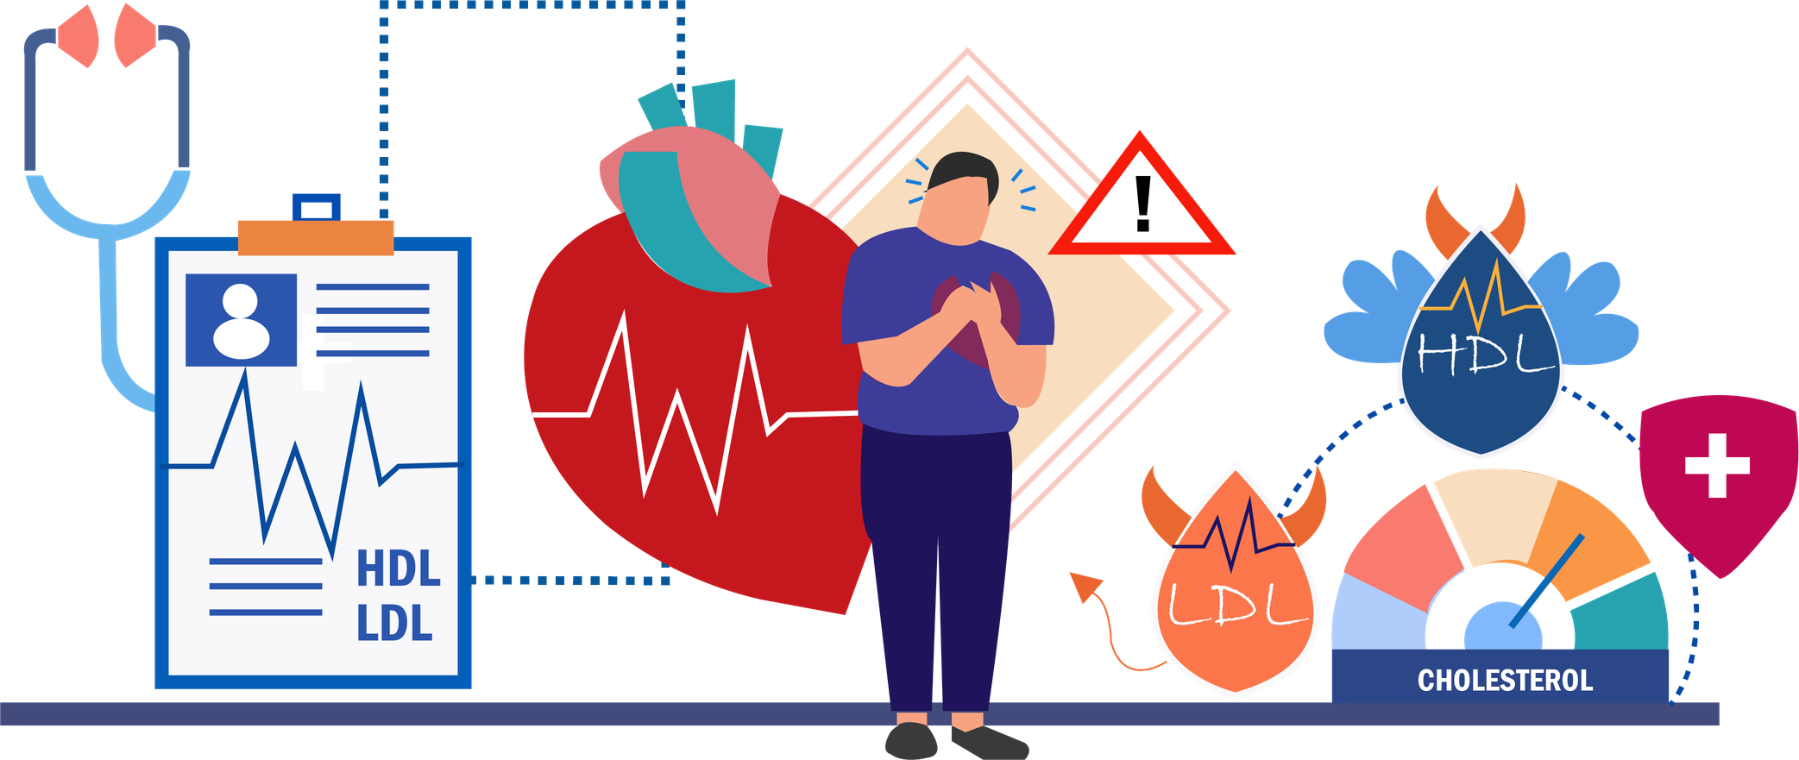
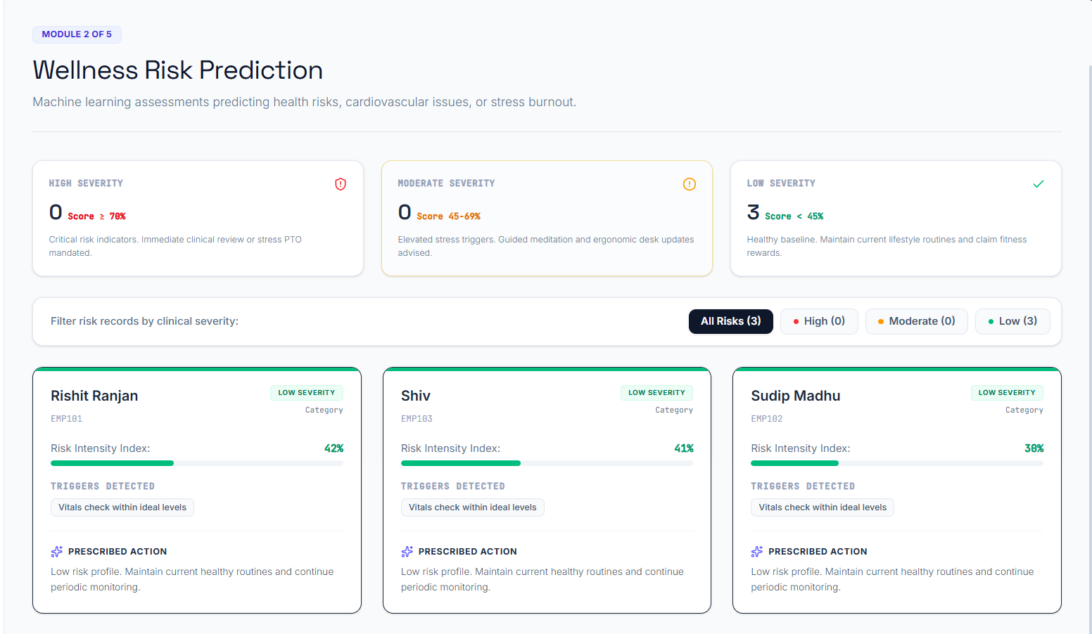
Wellness Risk Prediction
Predicting the Risk
Predicts stress and burnout.
Detects obesity and hypertension risk.
Uses historical and real-time data.
ML: Decision Tree, Random Forest

Slide 16


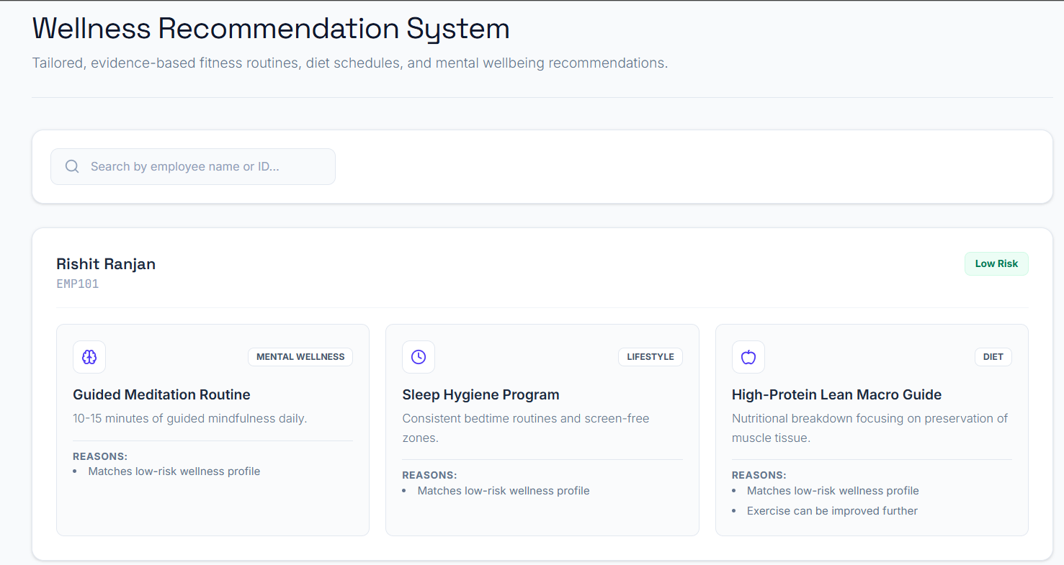
Personalized Wellness Recommendation
Employee Wellness Recommendation
Personalized fitness plans
Diet and lifestyle suggestions
Mental wellness and yoga activities
AI: collaborative filtering, content-based filtering, Generative AI

Slide 17


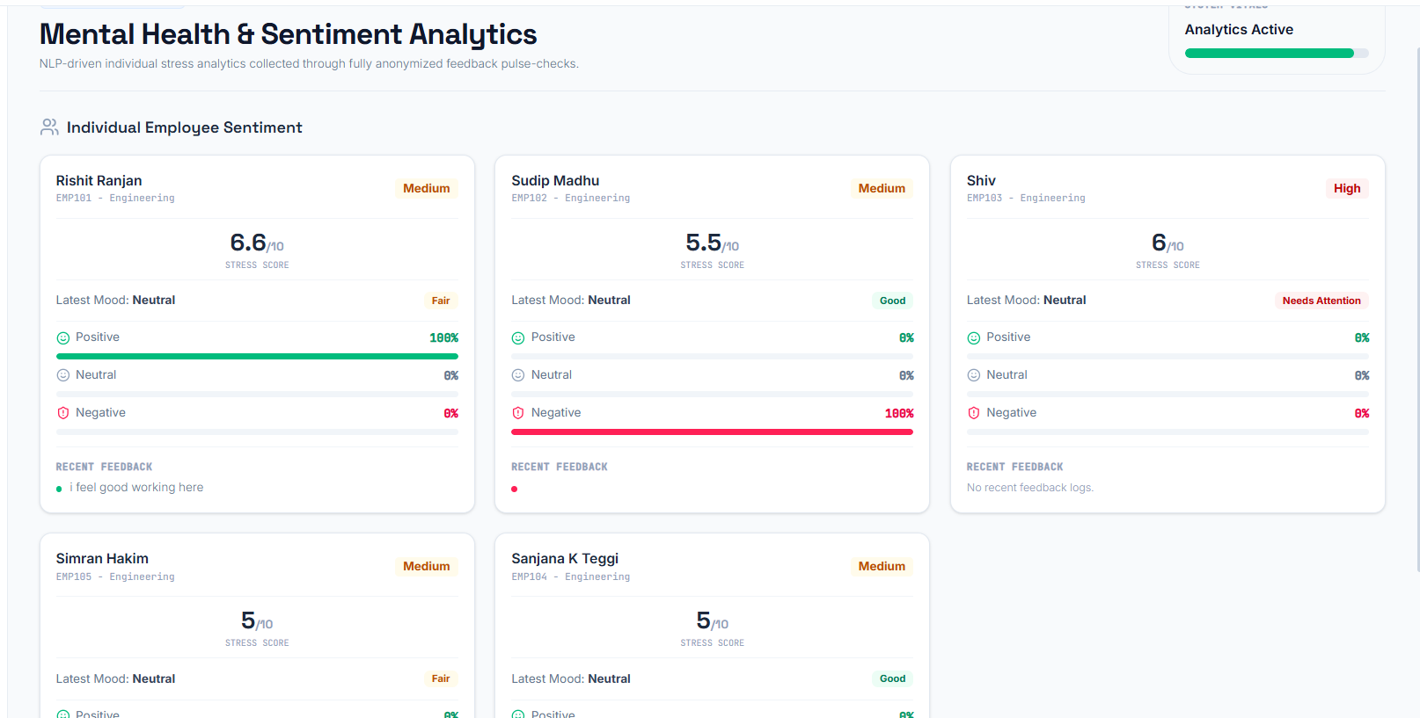

Mental Health &
Sentiment Analysis
Sentiment and Mental Health
Analyzes surveys and feedback.
Can use emails with consent and chatbot conversations
Detects stress, anxiety, burnout.
NLP, sentiment analysis, emotion detection

Slide 18

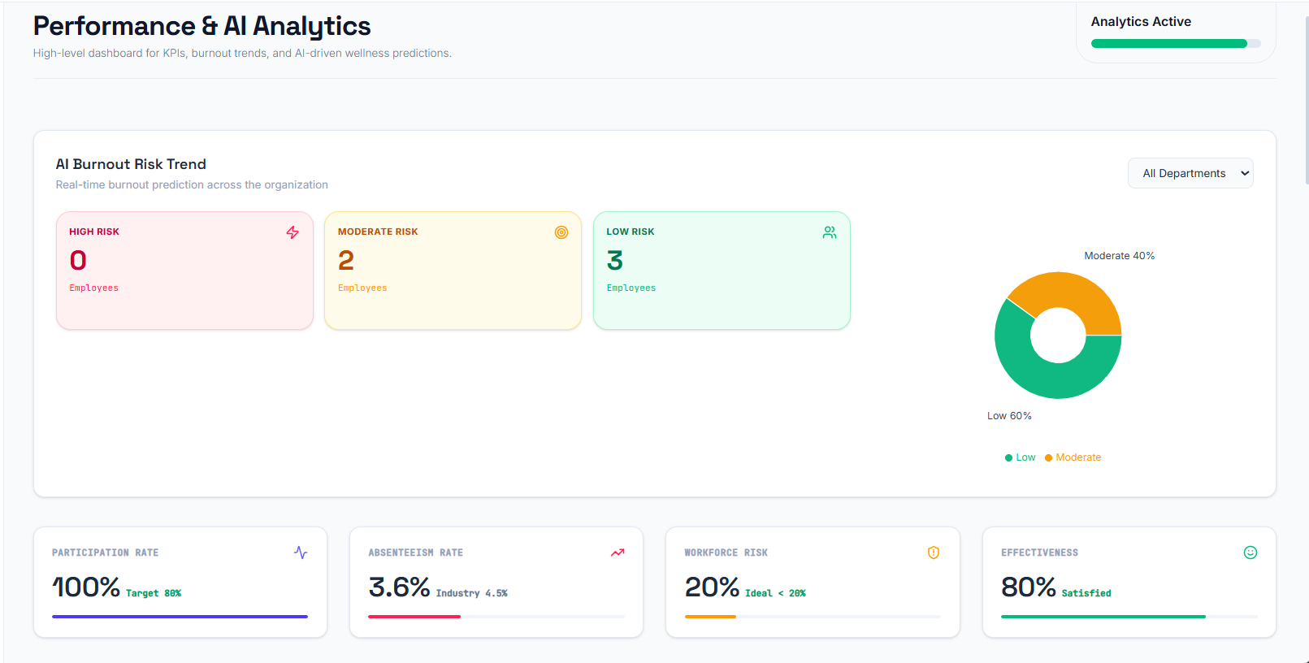
Performance
&
AI Analysis
Employee Performance Metrics
Tracks absenteeism and workforce health risk.
Measures wellness program effectiveness.
Helps admin monitor employee performance trends.

Slide 19

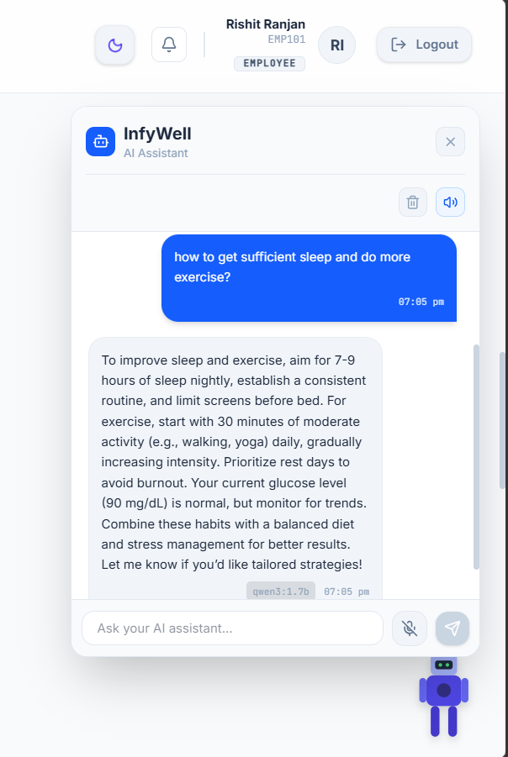
Chatbot Module
Chatbot Support and Assistance
AI-powered wellness assistant for employees.
Answers questions on sleep, diet, exercise, stress, and burnout.
Provides interactive chat support inside the user dashboard.

Slide 20



Additional
Features

Slide 21



Admin Dashboard

Slide 22


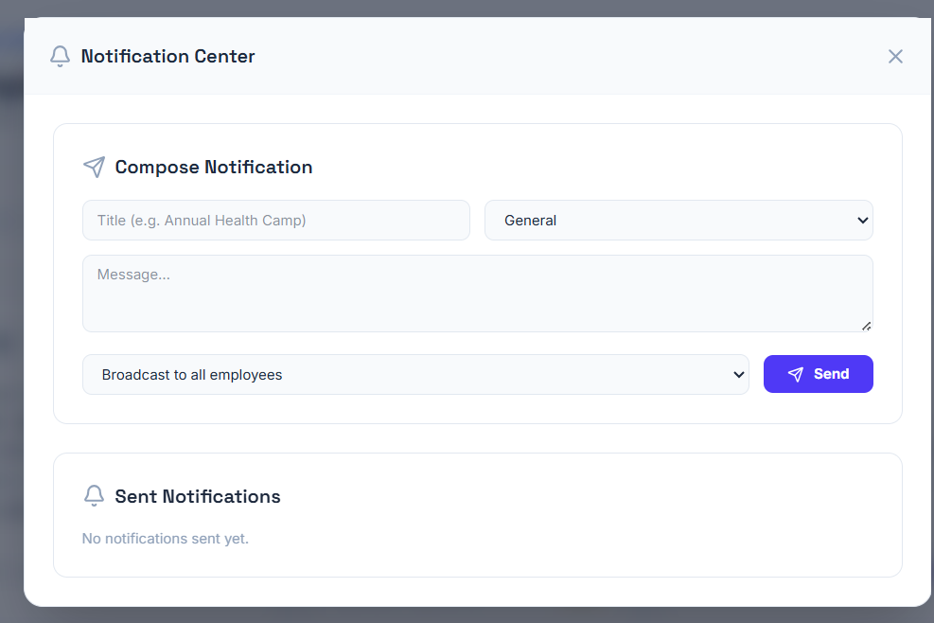


Notification Center
Added Features for Analytics
Broadcasting: Sends organization-wide announcements and updates to all employees simultaneously.
Targeted Messaging: Delivers tailored notifications, wellness reminders, or private alerts to individual employees.

Slide 23


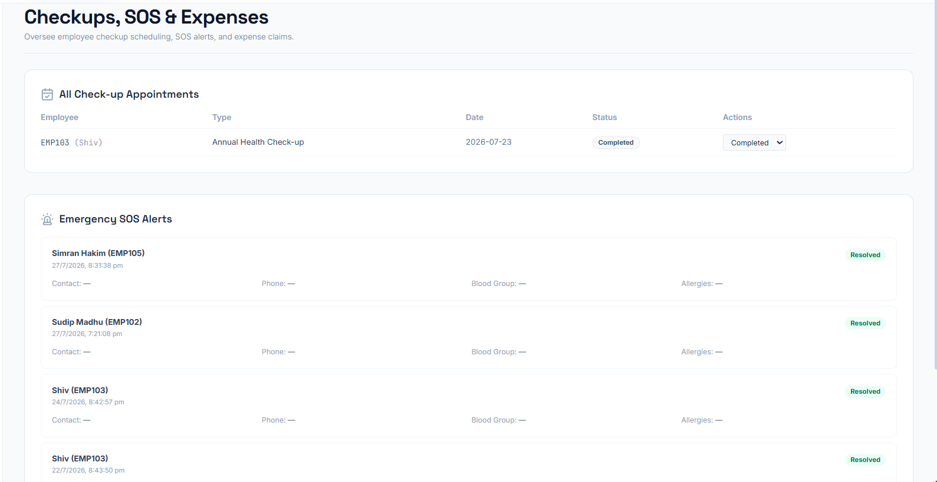

Checkups, SOS & Expenses
Added Features for Analytics
Emergency SOS Dispatch: Instantly alerts admins and emergency contacts with real-time location and vital logs during critical health events.
Checkup & Expense Tracking: Simplifies routine checkup scheduling while centralizing health insurance claims and medical expense records.

Slide 24


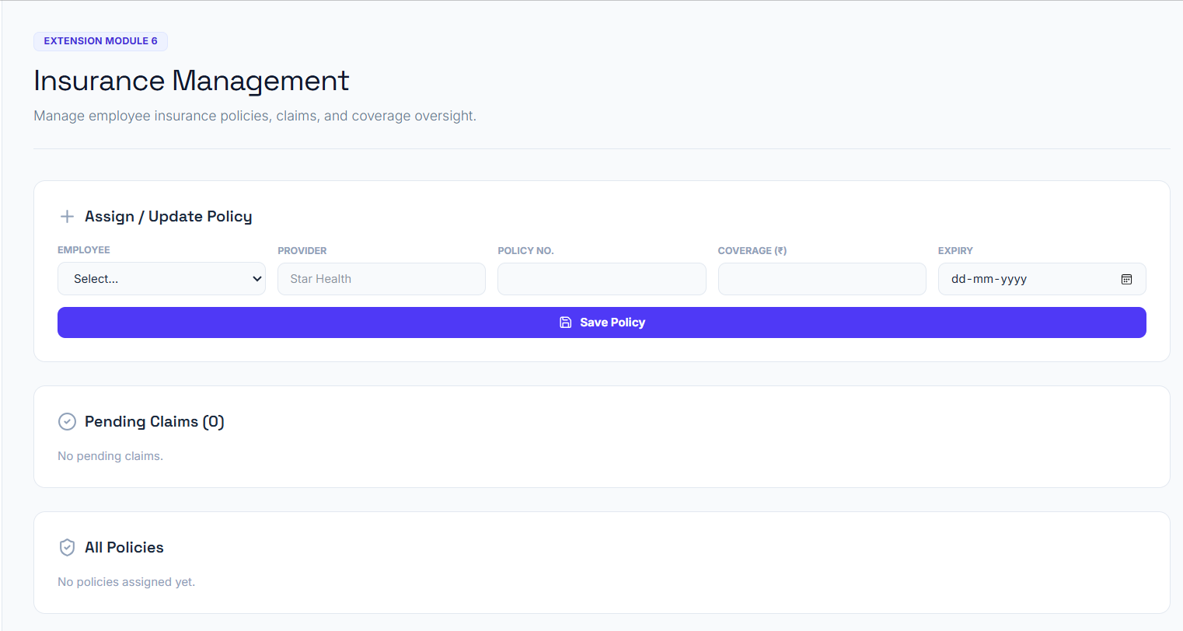
Insurance Management
Added Features for Analytics
Claims Management: Monitors the status of submitted employee medical claims from filing to approval.
Policy Monitoring: Tracks active insurance coverage, renewal dates, and individual benefit limits in real time.

Slide 25

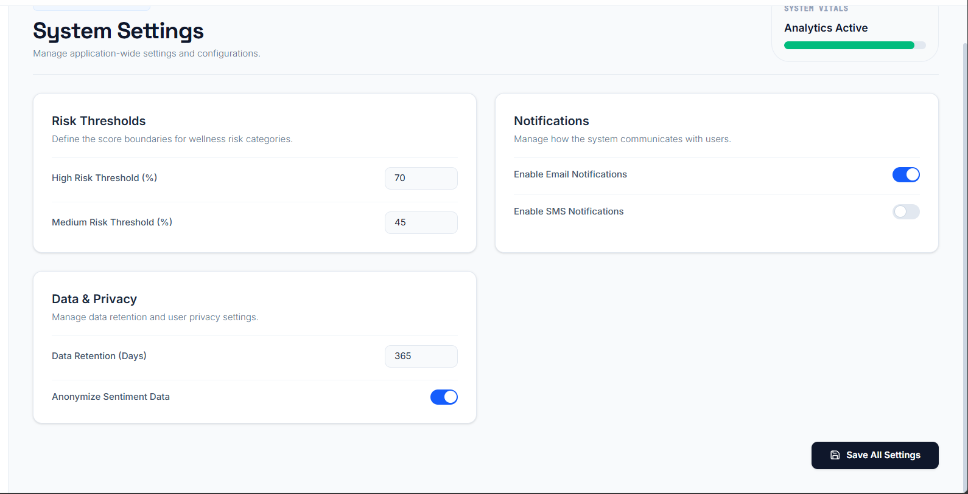

System Settings
Added Features for Analytics
System Configuration: Manages global application settings, feature toggles, and system-wide operational parameters.
Access & Security Rules: Controls role permissions, notification preferences, and platform security policies.

Slide 26



Employee Dashboard

Slide 27


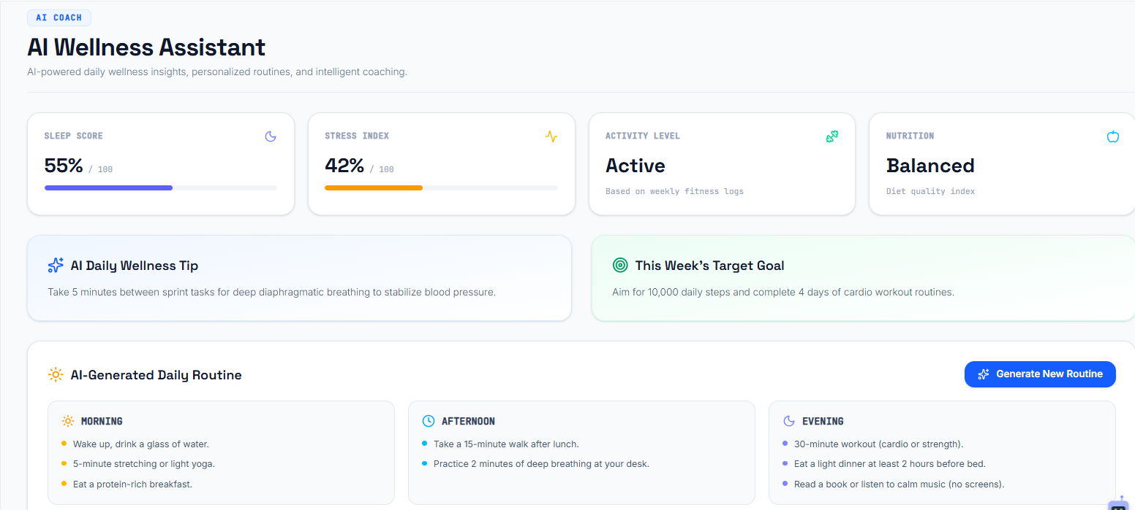
AI Wellness Assistant
Added Features for Wellness
Personalized AI Coaching: Delivers real-time, tailored health recommendations and lifestyle guidance to employees.
Automated Support: Provides 24/7 interactive assistance for daily wellness queries and mental well-being tracking.

Slide 28



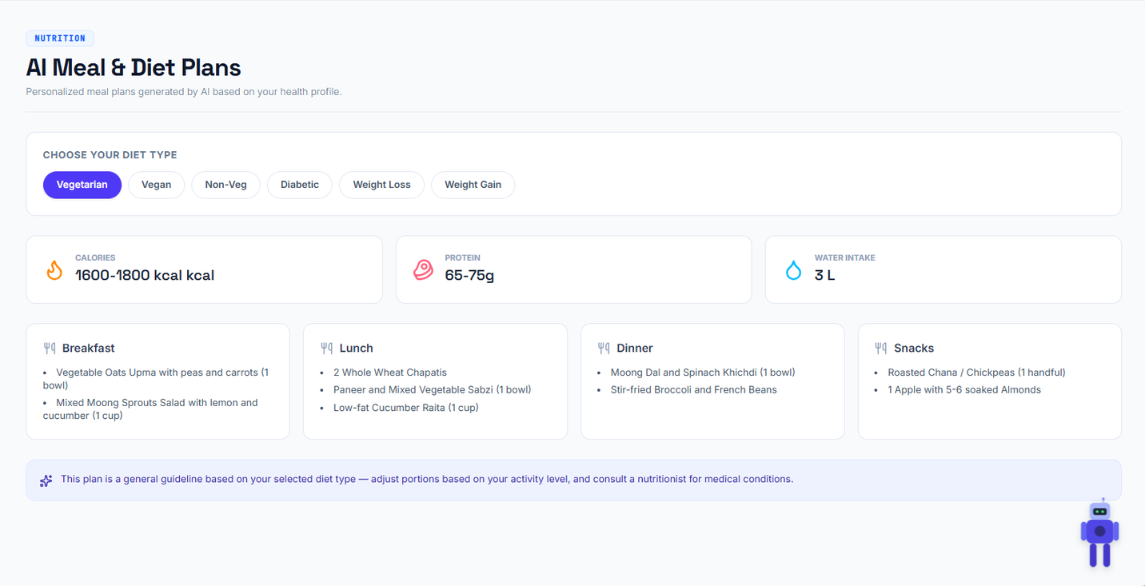

AI Meals and Diet Plans
Added Features for Wellness
Tailored Meal Plans: Generates customized diet plans matched to specific dietary types and user preferences.
Preference Tracking: Dynamically adjusts nutrition goals based on individual health choices and dietary restrictions.

Slide 29


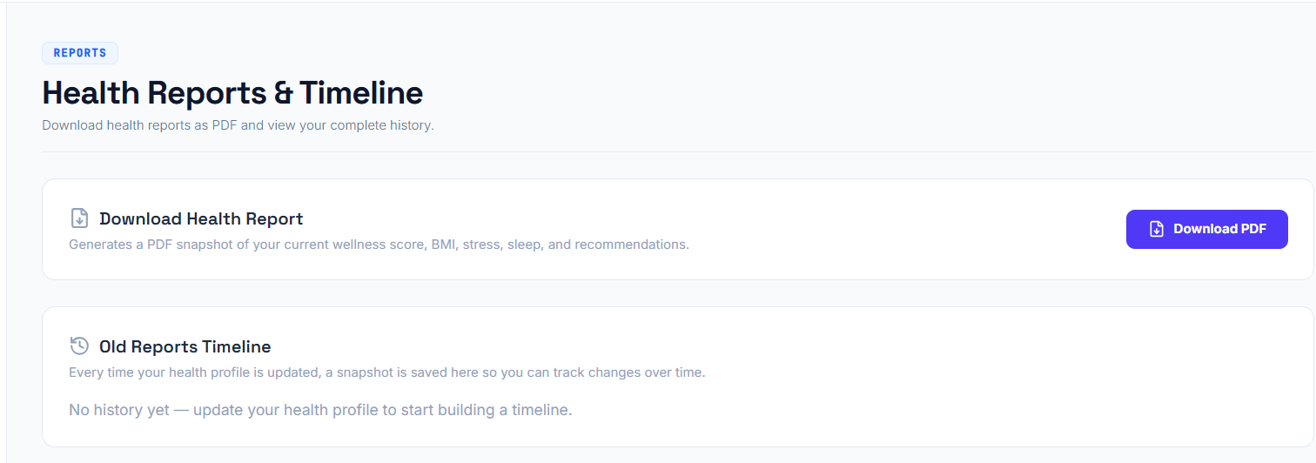


Health Reports and Timeline
Added Features for Wellness
PDF Report Generation: Exports comprehensive health summaries and wellness data into downloadable PDF formats.
Instant Sharing: Allows employees to easily save, print, or share personal health reports with medical professionals.

Slide 30

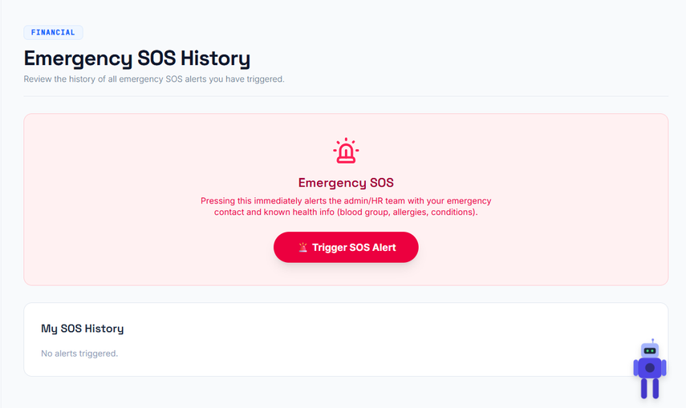
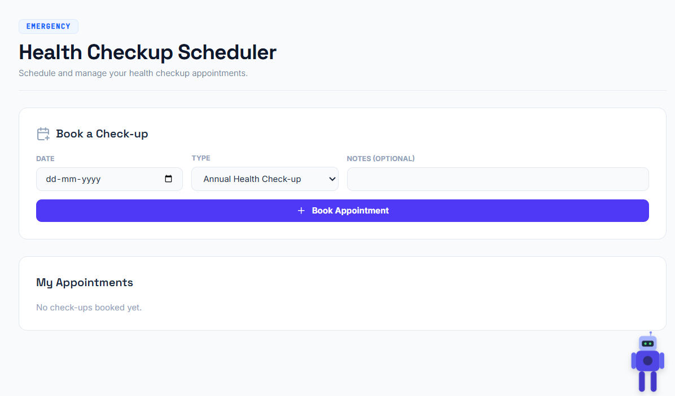

Checkups & Emergency SOS
Added Features for Wellness
Automated Checkup Scheduling: Streamlines health checkup bookings directly through the user and admin dashboards.
Emergency SOS Trigger: Instantly dispatches high-priority alerts with real-time location and vitals to emergency contacts during medical crises.

Slide 31



Conclusion
The project includes secure authentication, database integration, risk prediction, recommendation, sentimental analysis, performance analytics, and an AI wellness chatbot in one platform.
It supports both employee and admin roles for managing wellness data and system features.
These modules make the system more intelligent, interactive, and useful for future expansion.
Modular Scalability: Designed with an extensible architecture that allows seamless integration of future health-tech tools and wearable devices.
Real-time Incident Response: Combines continuous health metric tracking with automated SOS triggers and expense management for rapid emergency handling.

Slide 32

Thank you so much

